Slide 1
Metadata
OLAC 2012-10-18??
Robert Olendorf & Zoe Chao

Slide 2
Outline
Metadata
Descriptive
Administrative
XML and RDFa
MIA (metadata in action)
OAIPMH
Web search
Hands on exercise (METS)

Slide 3
What is metadata?
Content
How to structure
Syntax vs. Semantic

Slide 4
Metadata is essential in providing the means to describe, share, search, manage and preserve our digital resources, ensuring maximum potential for use and re-use throughout their lifecycle. The selection of metadata, and its management and administration, should be tailored to meet the specific needs of the collection and its various users, and follow established best practice, where it exists, within the community in which you are working. While metadata should be created focussing on the resource at hand, ideally some thought should also be made towards making it possible to share your data with other collections, catalogues and systems to maximise the potential use and re-use of resources.

Slide 5
What is metadata?
Does it have to be….
in XML?
in the Web environment?
machine readable?
for electronic resources only?

Slide 6
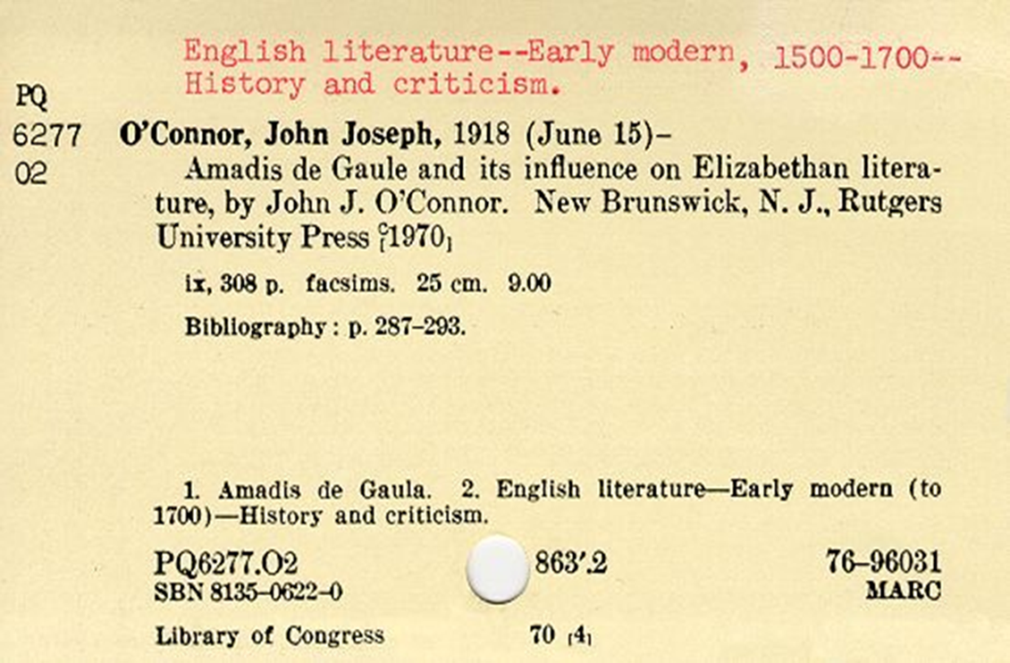
Is this metadata?

Slide 7
Metadata is…
data about data.
to impose some order in a disordered information universe. (Carl Lagoze)
constructed, constructive, and actionable. (Karen Coyle)

Slide 8
Metadata is…
“structured information that describes, explains, locates, or otherwise makes it easier to retrieve, use, or manage an information resource.”
NISO (2004). Understanding Metadata.
http://www.niso.org/standards/resources/UnderstandingMetadata.pdf
“structured, encoded data that describe characteristics of information-bearing entities to aid in the identification, discovery, assessment, and management of the described entities.”
ALA Committee on Cataloging: Description and Access

Slide 9
Boil down…
Structured data
Facilitate some types of actions
Find, identify, select, and obtain (FRBR)
Organization & management
The difference between data, metadata, and meta-metadata is often one of perspective. (Jenn Riley)

Slide 10

http://youtu.be/2wNTIPaBbPI

Slide 11
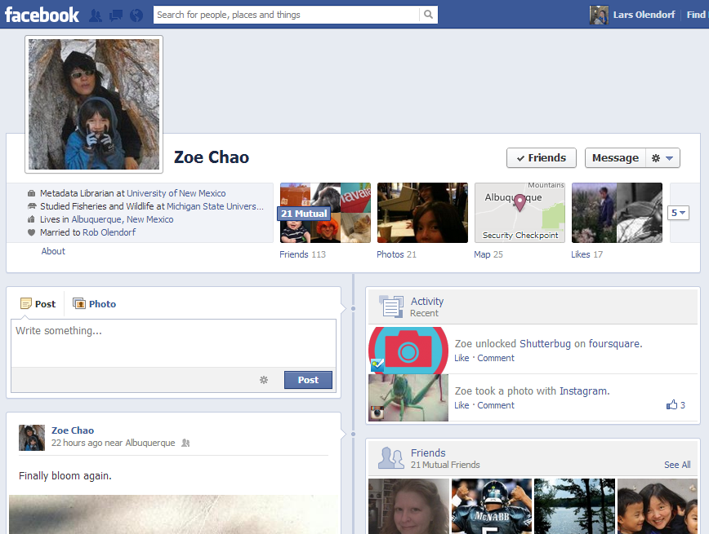

Slide 12
Types of Metadata
Descriptive metadata
identifies a resource and describes its intellectual content
title, author, keywords…
MARC, DC, EAD…
to find, access and manage

Slide 13
Technical metadata
focuses on how a digital object was created
format, identifier, date…
MIX, NISO Z39.87, TextMD…
Use: manage, access

Slide 14
Types of Metadata
Preservation / Provenance
contains information needed to archive and preserve a resource
OAIS, PREMIS
Rights
specifies intellectual property rights and permissions
CopyrightMD, Creative Commons
Structural
indicates how compound objects are put together, i.e. how pages are ordered to form chapters.
METS

Slide 15
Types of Metadata
Descriptive
Administrative
Technical
Intellectual Property Rights and Permissions
Digital Preservation / Provenance
Structural

Slide 16

http://www.flickr.com/photos/8601342@N03/8031470074/in/photostream

Slide 17
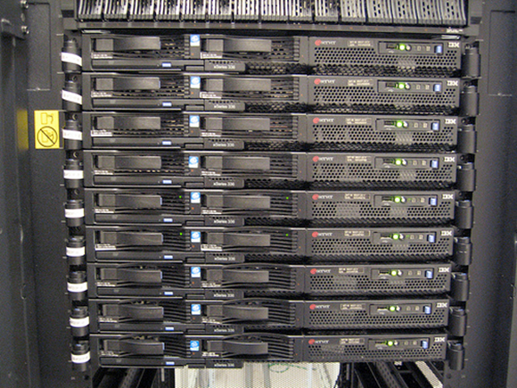
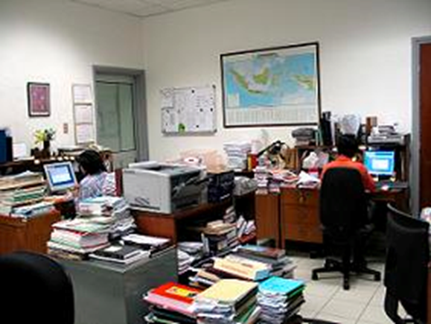
Who Creates Metadata?

Slide 18
Syntax vs. Semantic

Slide 19
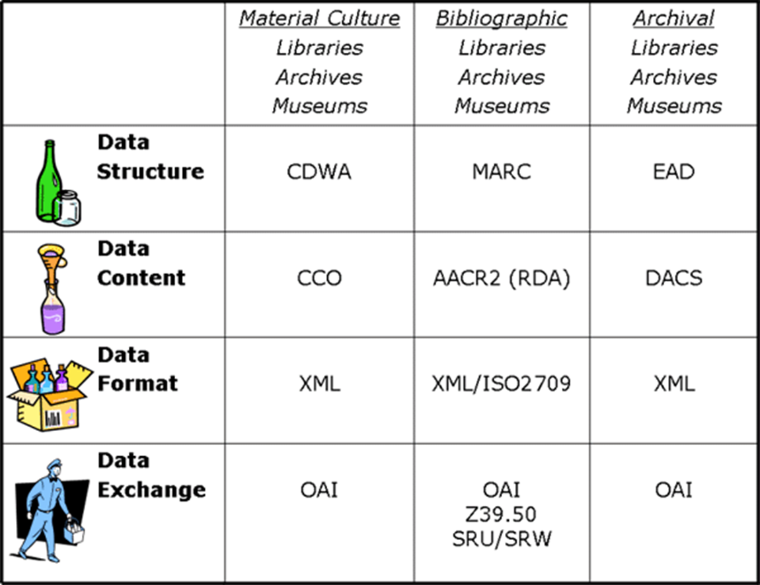
From “Metadata for All” by Elings & Waibel. <http://firstmonday.org/htbin/cgiwrap/bin/ojs/index.php/fm/article/view/1628/1543>
Notes:
CCO: cataloging cultural objects

Slide 20
How to structure?
Syntax: XML
Semantic: Metadata scheme
Semantic: Controlled vocabulary

Slide 21
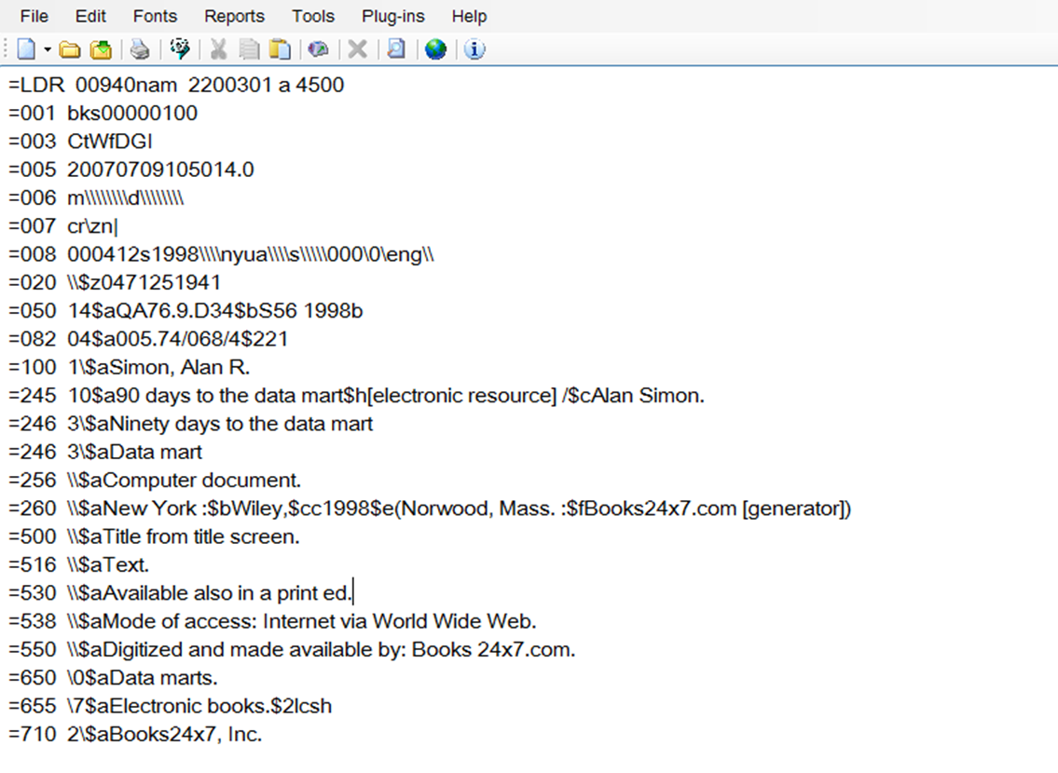
MARC

Slide 22
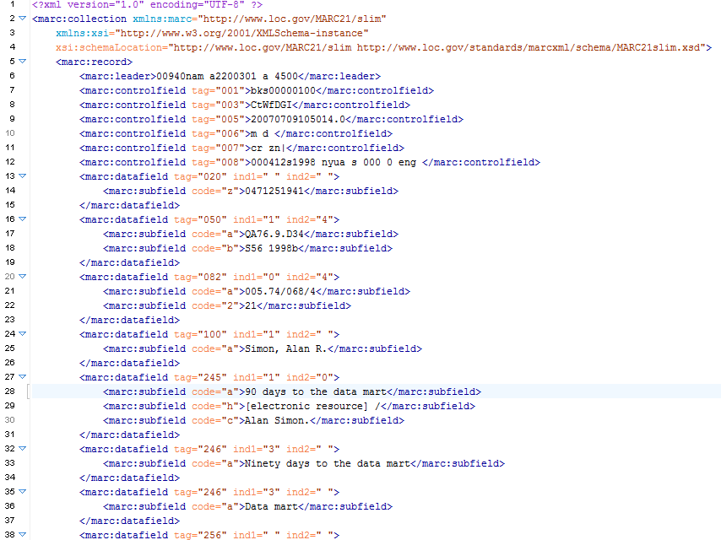

Slide 23
What is XML?
Why do we need markup?

Slide 24
Advantages of XML
Simple to understand and constructu
Universal
Both human and machine readable
Easy to transform

Slide 25
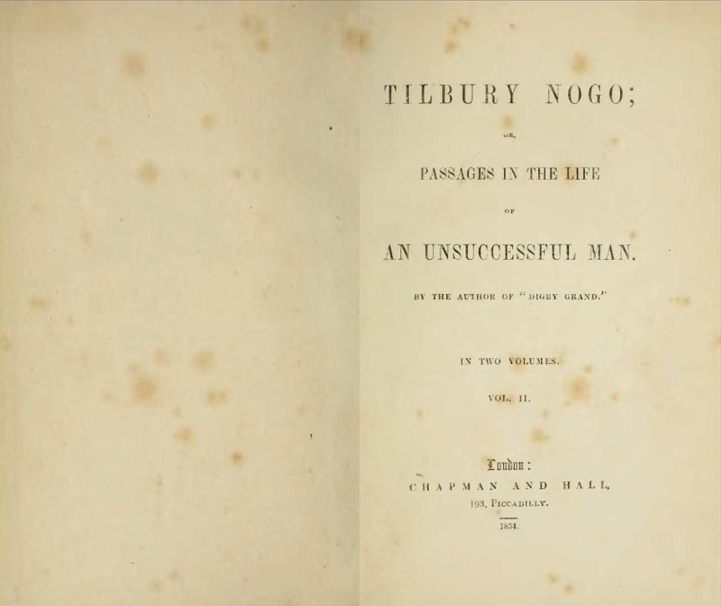

Slide 26
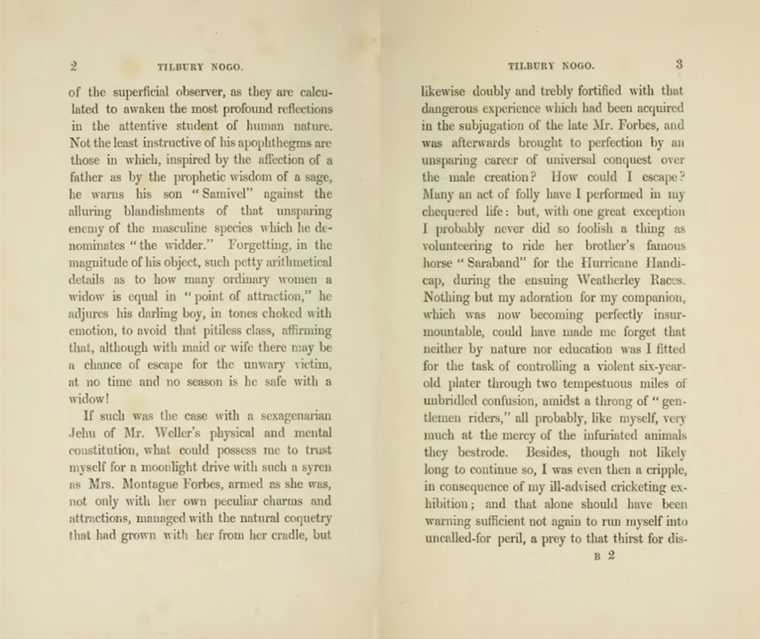

Slide 27
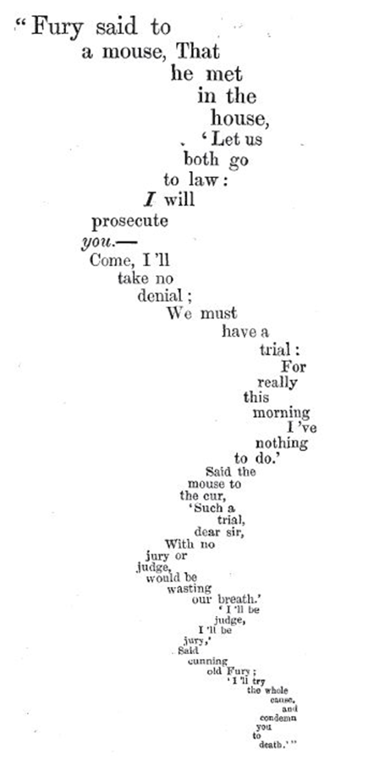
Lewis Carroll: The Mouse’s Tale

Slide 28
Syntax: how you say things
I love balloon fiesta!
Semantic: what it means
I love balloon fiesta!

Slide 30
What schema to use?
Simple schema (DC):
Complex schema
Application profile (mix and match)

Slide 31
Hands on exercise

